Slide 1

Labour Management System
Submitted By:
Lakshay Garg
University Roll No.
2018904
Mentored By:
Dr. Surendra Kumar Shukla
(Associate Professor)

Slide 2
Introduction
Labour Management System is based on a concept to store and generate all the records of the Labours. This program is considered as a simple database of Labour in an office, an organization where the user can store Labours record easily as it is not time–consuming.
Every organization, whether government or private uses an information system to store data and their staff. However, in India it is found that many small-scale industries use pen and paper to keep a record. However, there are many advanced technology systems available that can do this work.

Slide 3

This paper discusses making a system that is used for solving problems in a very convenient way. Here at first, the user has to pass through the login system to get access then he/she can add Labour’s data, view list of Labours , modify and remove Labour details. The whole project is designed in ‘C++’ language and different variables and strings have been used for the development of this project. This project is easy to operate and understood by the users. Labour Management System helps an organization to simplify the process of record maintenance. To make their work more effective, organizations must implement this system. This paper discusses the development procedure, problems faced and benefits of using the system.

Slide 4
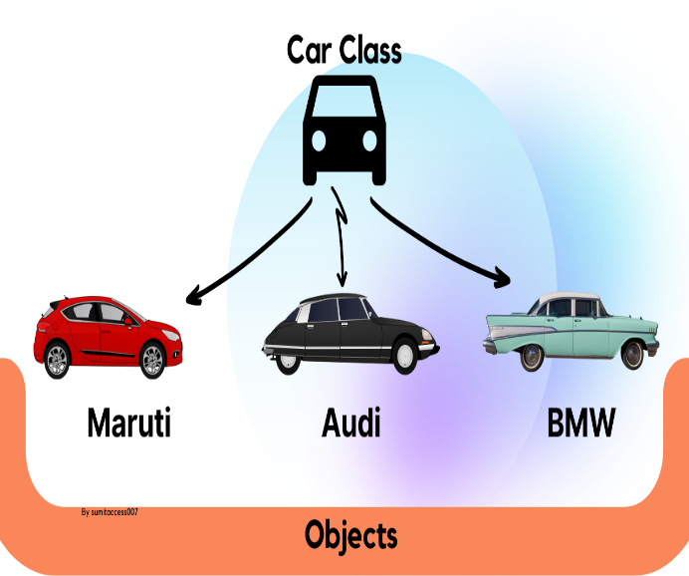
Methodology
This Labour Management System project is entirely based on object-oriented programming in ‘C++’ language.
C++ was developed by Bjarne Stroustrup, as an extension of C language.
C++ language is used to create high performance applications.
C++ gives programmers a high level of control over system resources and memory.
The following concept are used in the project:
Classes and objects: Class is a fundamental block of a program that has its own set of methods and variables. Object is the instance of class which can access the methods and variables of the class.

Slide 5
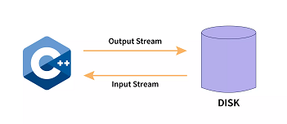
2) Functions: A function is a set of statements that take inputs, do some specific computation, and produce output. The idea is to put some commonly or repeatedly done tasks together and make a function so that instead of writing the same code again and again for different inputs, we can call the function.
3) File handling: File handling is used to store data permanently in a computer. Using file handling we can store our data in secondary memory (Hard disk). We can access that data whenever we needed.
This topic of file handling is further divided into sub-topics:
Create a file.
Open a file.
Read from a file.
Write to a file.
Close a file.

Slide 6
Result and Discussion
The result of this project is used to store and generate all the records of the Labour . Improving the efficiency and accuracy of labor management tasks by reducing manual data entry and streamlining workflows. It is very less time-consuming. In this modern era all the work should be done in such a way that it is easily understood by the users or by an organization.

Slide 7
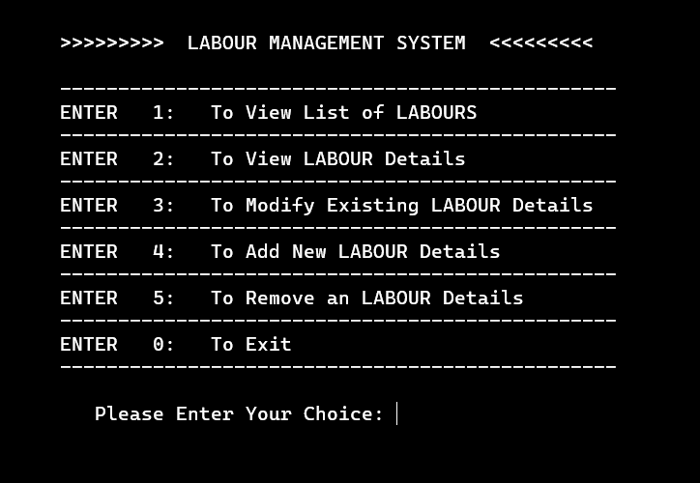
The function of this project is mentioned in below:
*****LABOUR MANAGEMENT SYSTEM*****

Slide 8
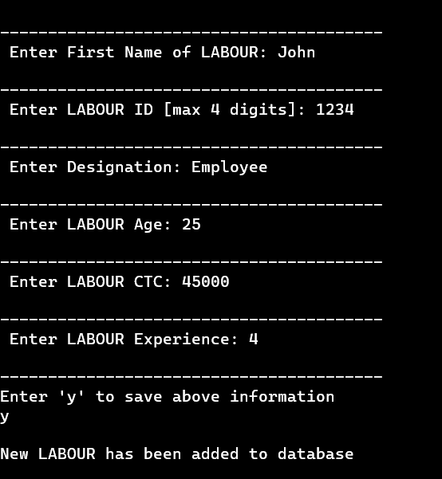
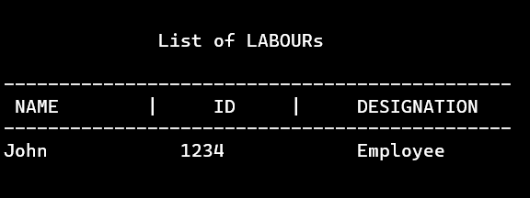
***Adding the Labour details***
***To view list of Labours***
The System helps in increasing productivity and cost-savings, and any future opportunities for improvement or expansion.

Slide 9
Conclusion and Future Work
Labour management systems helps an organization to improve workforce productivity and boost overall well-being by monitoring and maintaining the record of the Labour.
There are several areas where further work can be done to improve the functioning of the Labour Management System.
Adding a scheduling feature for shift management.
Implementing automated leave management system.
Incorporating a payroll module to automatically calculate and process employee salaries and taxes.
Developing mobile application for employee to access the system from their mobile devices.

Slide 10

Thank you

